Slide 1
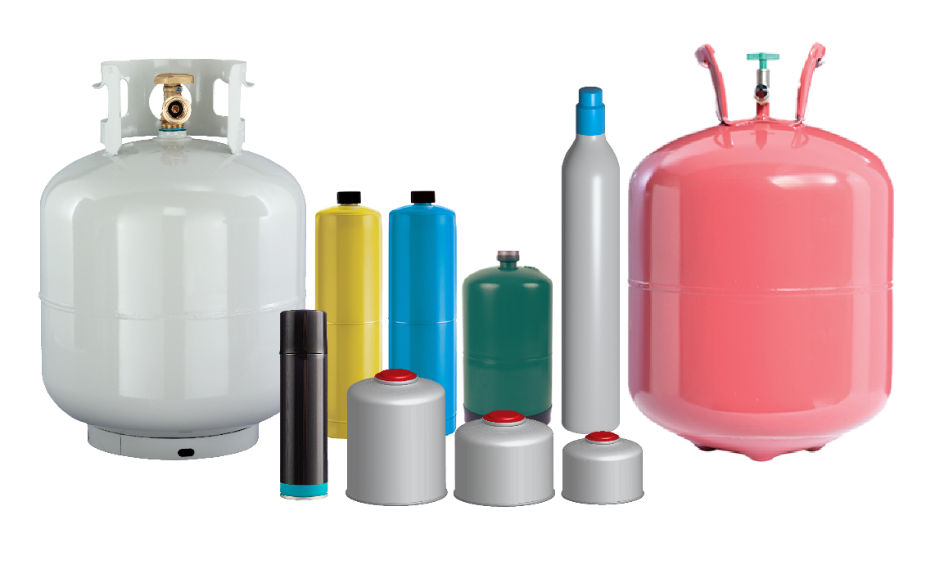
Update on The Cylinder Collective Stewardship Program for Pressurized Cylinders in Connecticut
Connecticut Recyclers Coalition Annual Meeting
October 24, 2024

Slide 2
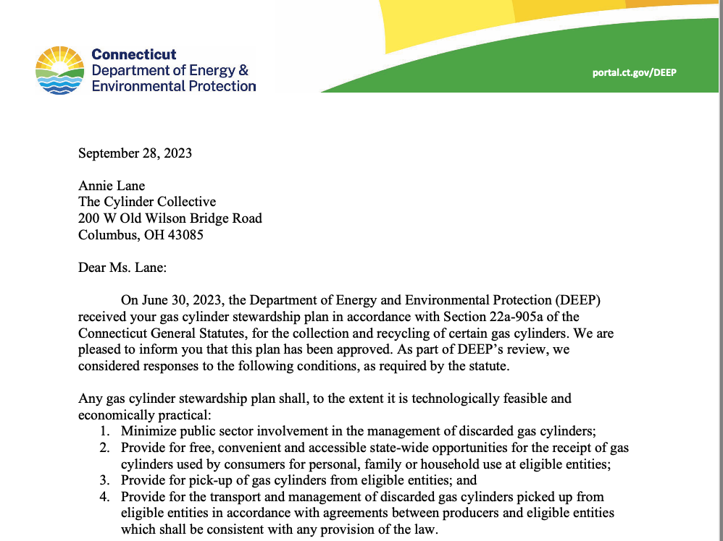

The Cylinder Collective Stewardship Program
Plan was approved September 28, 2023.
First year concentrated on resourcing the organization, establishing systems, and outreach to key contacts.
Now, focused on producer recruitment, developing contracts with vendors, and securing collection sites.
Future development of outreach and education program and materials.
www.cylindercollective.org/

Slide 3
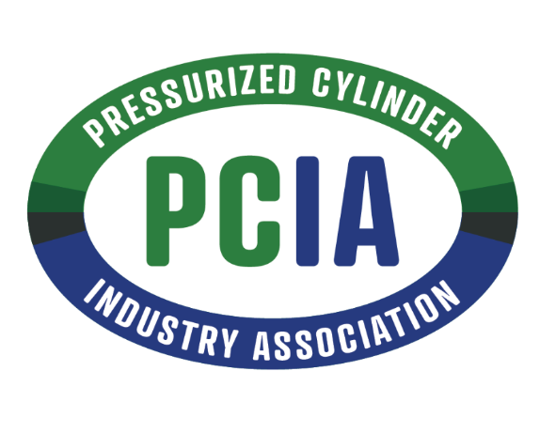

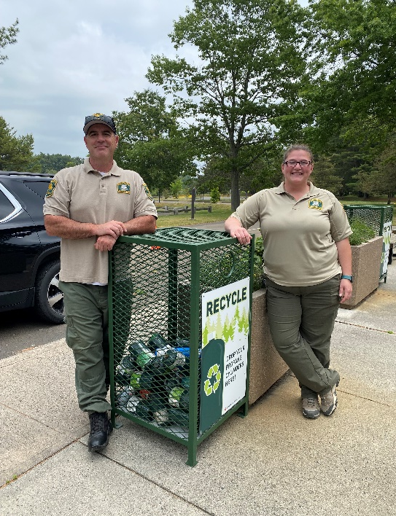
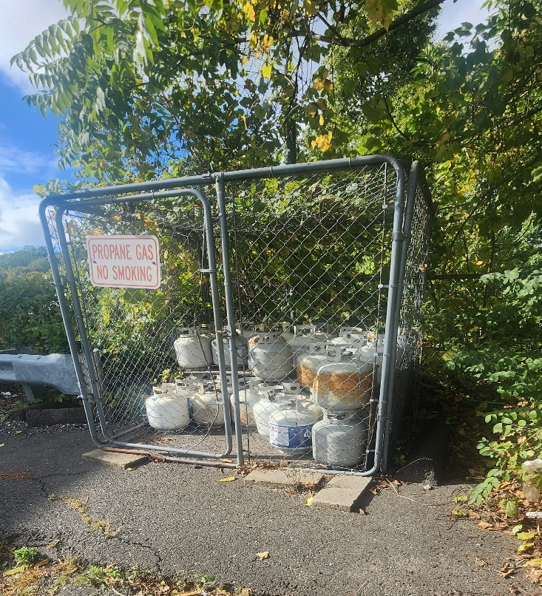
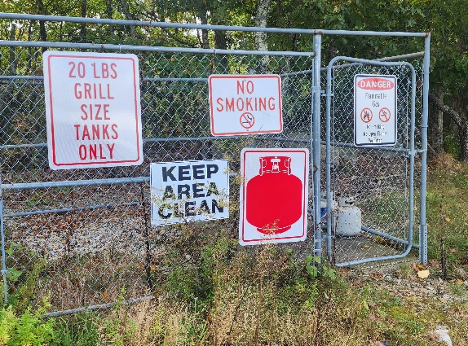
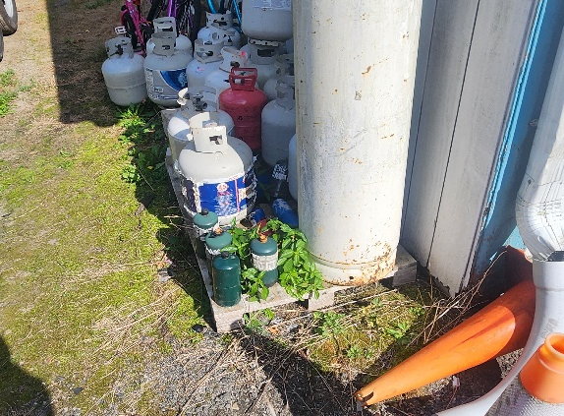
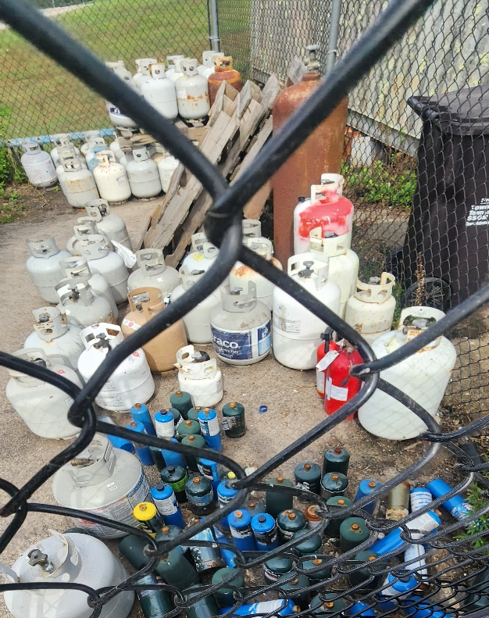
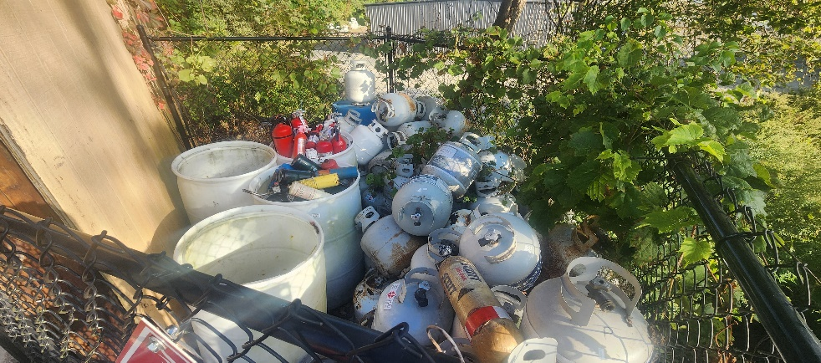
Milestones
Pressurized Cylinder Industry Association (trade association) and The Cylinder Collective (producer responsibility organization) incorporated.
Executive Director hired.
Voluntary parks pilot program conducted last two camping seasons. Third year will expand types of cylinders collected and come under TCC control.
Begin candidate search for
State Program Coordinator.

Slide 4
Candidate search for State Program Coordinator
Timeline:
Interviews through December
Hire in January 2025

Slide 5
Participating Producers
Connecticut’s extended producer responsibility (EPR) law for gas cylinders CT Public Act 22-27 and the amendments passed into law by CT Public Act 24-133 required producers to join an approved cylinder stewardship program by
October 1, 2024
The list below includes producers participating in The Cylinder Collective as of October 21, 2024.
Worthington Industries Inc.
Johnson Outdoors Inc.
YSN Imports LLC dba Flame King
GSI Outdoors, LLC
Manchester Tank & Equipment Co.
The Coleman Company, Inc.
Representation by The Cylinder Collective is open to all pressurized cylinder producers.
Two other program plans from Sodastream and Propane Gas Association of New England (PGANE) were approved by CT DEEP. The Cylinder Collective plans to collaborate with the other gas cylinder programs.
7. Unique Industries, Inc.
8. Liberty Mountain Sports LLC
9. Cascade Designs, Inc.
10. BSD Trade LLC (Jo Chef)
11. Snow Peak USA
12. Sterno Group

Slide 6
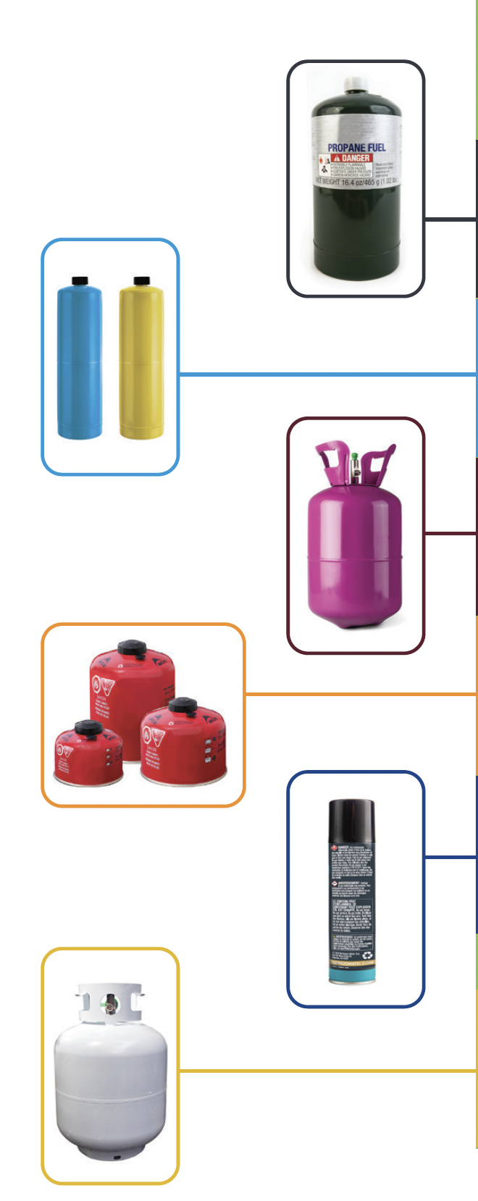
In Scope / Exclusions
Types of Cylinders
Non-Refillable
16 oz Propane
14 oz Fuel Torches (Propane, MAPP)
Helium
4 – 16 oz Isobutane
5 – 8 oz Butane
Refillable
under 20lb propane (20 lb. Tank collected by PGANE program)
In Scope:
all refillable and non-refillable types of designated cylinders (with a water capacity between 0.5-50lbs) that participating producers supply into Connecticut
Plan will adjust if new members subscribe (e.g., refillable and non-refillable CO₂ cylinders)
Exclusions:
Supplied to industrial, commercial and institutional consumers and pressurized cylinders
Containing oxygen, refrigerants, acetylene, hydrogen, ethylene and foam adhesives
Fire extinguishers
Water capacity of under 0.5 lbs or over 50 lbs

Slide 7







Collection System
Collection system will rely on various locations:
Municipal drop off sites/events
Transfer stations/recycling facilities
Campgrounds – public and private campgrounds
State parks – 12 state parks w/ overnight, 2 state forests w/ overnight
Possible future pilot at retail locations
Where collection gaps exist, the program will explore options in those geographic areas
Collection sites would be required to meet program operational standards, e.g.,
Compliance w/ reg. requirements for collection, handling & staff training
Secure storage
Record keeping
No charge for residents to drop off cylinders
Collection services will be monitored to identify:
Best practices that could be adopted by other collection sites
Geographic areas that would benefit from additional collection service
Collection sites that are not used by residents.
MUNICIPAL
DROFF-OFF
TRANSFER
STATION
DISPOSAL &
RECYCLING
FACILITY
HHW EVENTS
PILOT AT
RETAIL
STATE
PARKS
CAMPGROUND

Slide 8
Pick-up, Transport & Management
Agreements will be established with licensed transporters and processors
Transporters and processors will be required to meet program operational standards including timely pick-up services, tracking of materials and compliance with regulatory requirements
Collection sites will be serviced by transporters either on a regular schedule or an on-call basis, as appropriate for a specific collection site
Refillable pressurized cylinders delivered by residents to a program collection location will be transported to a facility where:
Cylinders will be inspected, recertified, refilled, and returned to the exchange system / other reuse opportunities; or
If a cylinder cannot be recertified, the residual gas and cylinder will be properly managed
Empty non-refillable cylinders will be transported to a facility where the residual gas and cylinder will be properly managed

Slide 9
Promotion & Education
Focus on the following objectives:
Increasing awareness of how to properly manage pressurized cylinders;
Encouraging the use of the 20 lb refillable cylinder exchange system; and
Influencing behavior change to manage non-refillable pressurized cylinders through delivery to the program collection network.
Education and outreach to engage Connecticut residents will be provided through communication tools such as:
Program website that provides a central hub to educate consumers on why, how, and where to recycle cylinders accepted by the program. The website will include a list of searchable collection locations by address and zip code that will be regularly updated to ensure timely, accurate information for consumers. Search-engine optimization (SEO) will make the website more visible on search engines like Google, and the website address will be featured prominently in communications. In addition, the website will include program annual reports.
Print materials, including messaging and graphics that can be used in brochures, fact sheets, backgrounders, fliers, signs and posters at partner locations (e.g., state parks, municipal and retail locations)
Development of The Cylinder Collective logo that could be used by members as part of product labels to assist with messaging.

Slide 10
Performance Goal
 | Collection and Diversion
Accessibility (both refillable and non-refillable cylinders) | At a minimum in the first year, 50 collection sites or events in the State
Non-Refillable Cylinder Performance Target | By the 5th year of the program, 100,000 cylinders collected per year
A performance target for refillable cylinders has not been proposed as it is not possible to determine the percentage of cylinders not returned through the exchange system.

Slide 11
Tracking & Measuring Performance
Proposed annual performance metrics for refillable and non-refillable:
# of collection locations by type (municipal, campground, park, retail) and # of special events in each county
# of refillable and non-refillable cylinders collected
# of refillable cylinders recycled/reused (i.e., returned to the exchange system and number sent to scrap metal recyclers)
Tons of non-refillable cylinders sent to scrap metal recyclers
Collection Rate (%) = [Tons of non-refillable cylinders collected / tons of non-refillable cylinders supplied to consumers] x 100
Diversion Rate (%) = [Tons of non-refillable cylinders recycled / tons of non-refillable cylinders supplied to consumers] x 100

Slide 12
Questions and Feedback
David Keeling
Executive Director
Pressurized Cylinder Industry Association/ The Cylinder Collective
DavidKeeling@cylinderindustry.org
www.cylinderindustry.org/
www.cylindercollective.org/

